Slide 1
JNCIS-ENT
Intermediate System to Intermediate System (IS-IS)

Slide 2
IS-IS Scalability
4
Multi-level and multi-area IS-IS

Slide 3
Multi-Level IS-IS
L1 routers will not form an adjacency with an L2 router
Similarly, L2 routers will not form an adjacency with an L1 router
For L1 adjacencies to form, the configured area ID must be identical
For L2 adjacencies, the area ID may be the same or different

Slide 4
Why Use Multi-Level?
Much like OSPF, multi-level IS-IS is primarily used to limit the size of LSDBs
No LSPs flood from L2 to L1 by default and may be allowed selectively
Can limit the impact of flapping links or malfunctioning devices
Since the LSPs will not flood from L2 to L1, L1 areas are shielded from rapid changes to the network

Slide 5
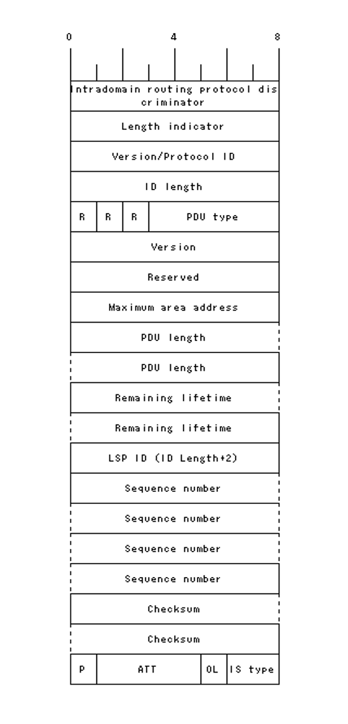
Level 2 Attached
Different LSPs for L1 and L2, an L1/L2 router will send both types depending on adjacency
An L1/L2 router will set the attached bit in L1 LSPs it originates
There are 4 bits in the LSP frame format dedicated as ATT
Depending which one is set determines the metric type to be used
Bit 4: default metric
Bit 5: delay metric
Bit 6: expanse metric
Bit 7: error metric
L1 routers that receive an LSP with the attached bit set will generate a default route towards the originating router.

Slide 6
L2 Route Leaking
By default, routers will not flood L2 LSPs into L1 areas
This can cause sub-optimal routing as the L1 router will always pick the metrically closest L2 router to reach a destination outside its area
L1 LSPs are always flooded into L2 areas
The backbone area must maintain full connectivity to all destinations

